Slide 1
E-Commerce Recommender “WE-RECOMMEND”
By Wayne Nguyen, Hongcheng Jiang,
Fei Wu, and Zhaobin Zhang

Slide 2
Vision Proposal
Current product recommenders and predictors are based on click/purchased activities that ignores the visual content.
As a predominantly visual species, Team Royals want to fill in this technology gap with our deep learning visual e-commerce recommender application “We-Recommend”.
Incorporation of any image source with proven deep learning algorithms to better predict the actual product. This can eliminate ‘cold starts’ and give better results providing the user an individually tailored experience.

Slide 3
Project Plan
Features/Requirements
Registration/Sign-in
Image importer with tags
Deep Learning Algorithm/API
Knowledge search bar
Result output page for product
Deep learning product suggestions
Product recommendation stores/sites
Easy to use UI
Location technologies/Future scope

Slide 4
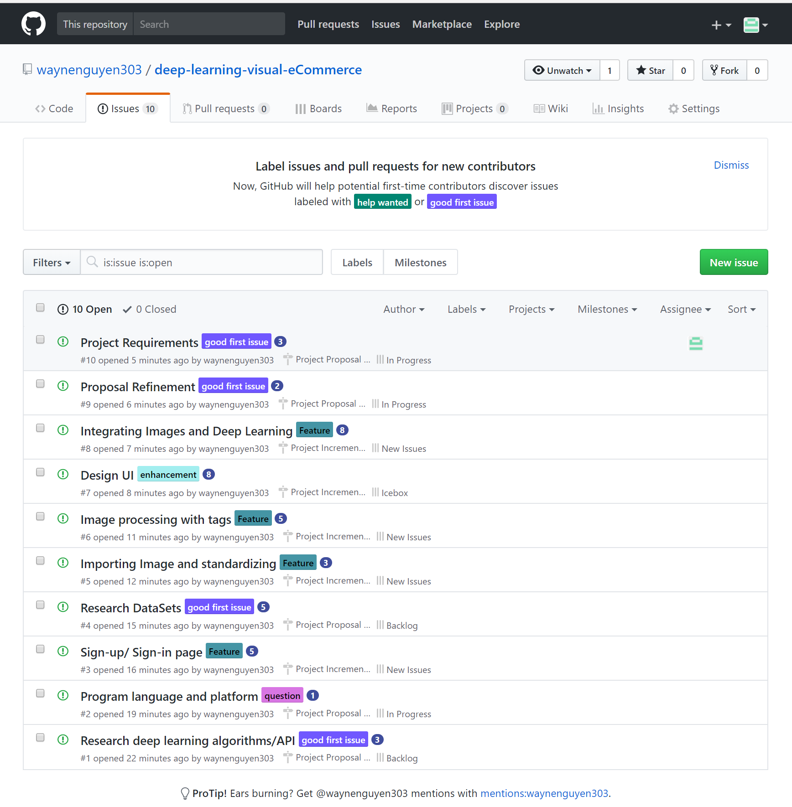
ZenHub Issues and Task

Slide 5
Thank You

